Slide 1







SQL MINI PROJECT
Google Play Store:
App Market Analysis
A data-driven SQL showcase analyzing user sentiment, pricing strategy, and category trends for strategic app launches.
TECHNOLOGY STACK
PRIMARY DATASET
REPORT DATE
MySQL • Python
Kaggle Play Store CSVs
July 11, 2026
Notes:
Hi everyone, we're Berker and Matteo from Northbeam Studio. Today we're walking you through the market analysis behind our next app launch.
We're about to launch our next app, and before we commit budget and developing time, we wanted a real, data-backed answer to two questions: should this app be free or paid, and which category gives us the best shot at succeeding? So, we pulled Play Store market data from Kaggle and ran a full SQL analysis to build our launch strategy.

Slide 2
















Project Overview and Business Objectives
BUSINESS CASE CONTEXT
An app developing agency is currently in the pre-launch phase. To ensure a successful market entry, they require a data-driven pricing and positioning strategy.
PROJECT OBJECTIVES
STRATEGIC_MANDATE
Quantify factors associated with higher app ratings.
Deliver a recommendation proven by SQL analysis of historical Play Store performance and user sentiment data.
Analyze sentiment polarity across pricing models.
Benchmark pricing tiers per category.
CORE ANALYTICAL QUESTIONS
Identify high-traffic segments via install counts.
Should the next app launch be Free or Paid to maximize sentiment and ratings?
Which App Category offers the best intersection of high ratings and high install volume?
How does Review Volume correlate with perceived app quality and user loyalty?
Notes:
We are in the pre-launch phase, and we need this pricing and positioning decision backed by data, not a gut call.
We set four objectives: quantify what actually drives higher app ratings, analyze sentiment across free versus paid apps, benchmark pricing tiers by category, and identify which categories give us the most reach through install volume.
That comes down to three core questions we needed to answer: should our app be free or paid, which category gives us the best combination of strong ratings and high installs, and does review volume actually tell us anything about how good an app is? Those three questions are exactly what our analysis answers next.

Slide 3

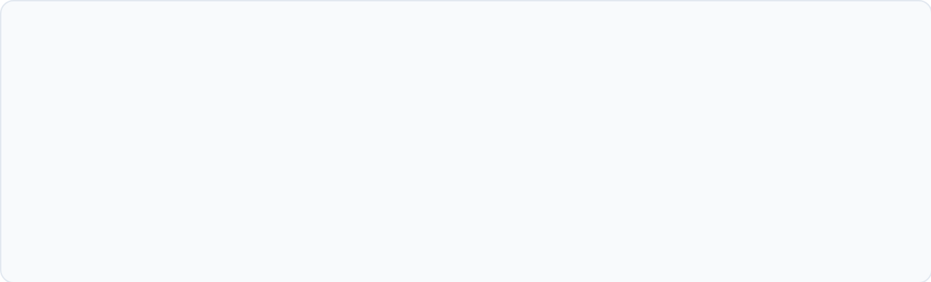
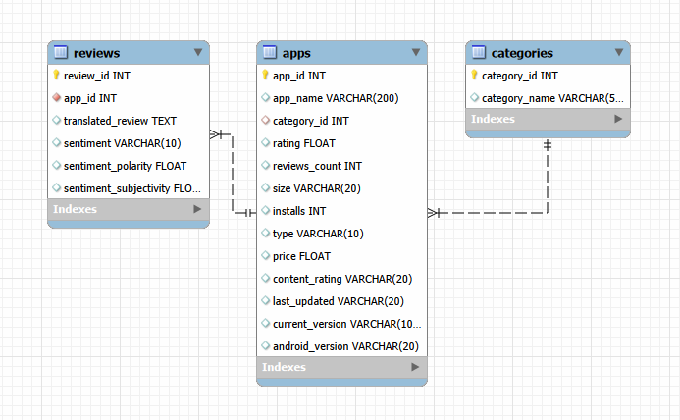

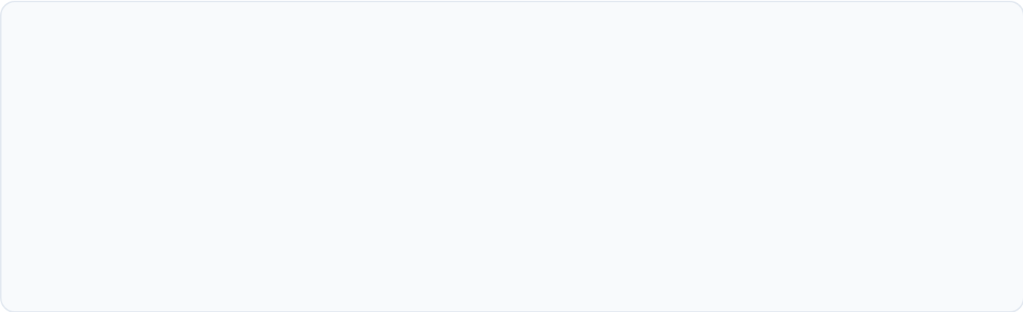





Data Sources & Study Scope
googleplaystore.csv
Primary dataset containing app-level metrics
Key fields: App Name, Category, Rating, Reviews
Market attributes: Installs, Type (Free/Paid), Price
googleplaystore_user_reviews.csv
Secondary dataset providing sentiment analysis
Attributes: Translated_Review, Sentiment, Sentiment_Score
Linked to apps via a numeric app_id key, not name
Python Cleaning
MySQL DB Load
SQL Query Analysis
Notes:
We built this on two datasets.
Our primary source has app-level metrics — category, rating, installs, price, type.
Our secondary source gives us user reviews with sentiment scores already calculated.
The two didn't line up cleanly by app name, so during cleaning we linked reviews to apps using a numeric app ID instead. From there we built a 3-table relational database — categories, apps, and reviews — so we could actually query this properly in MySQL.

Slide 4






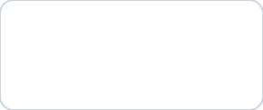
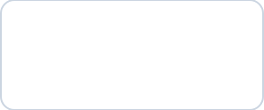
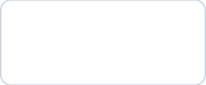














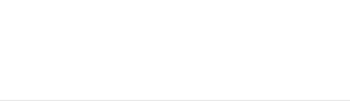
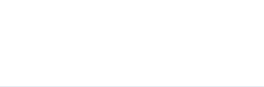
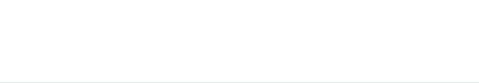

Data Cleaning & Preparation Results
#
STEP
ACTION
RESULT
10,356
01
Load Raw
pd.read_csv()
483
4.19
10,841 rows × 13 cols
Final clean rows
Duplicates removed
Mean rating used for fill
02
Remove Duplicates
drop_duplicates()
−483 rows → 10,358 rows
DATA QUALITY NOTES
03
Rating Nulls
fillna(mean)
Genres — excluded
1,474 nulls filled — mean = 4.19
Multi-value strings (e.g. "Tools;Education") require a junction table; kept out of the 3-table schema.
04
Drop Sparse Nulls
dropna(subset=[...])
−2 rows → 10,356 rows
Installs — text → int
Values stored as "10,000+"; commas and "+" stripped then cast to integer.
05
Fill Version Nulls
fillna('Unknown')
8 + 3 values filled
Price — text → float
06
Fix Numeric Types
str.strip() → cast
Values stored as "$4.99"; leading "$" stripped then cast to float.
Rating nulls — imputed
Reviews → int; Installs, Price → float
1,474 missing ratings filled with column mean (4.19) to preserve row count for joins.
07
Build Categories Lookup
factorize()
33 unique categories → FK-ready IDs
08
Final Validation
df.isnull().sum()
Pipeline Complete — Schema-Ready
Zero nulls confirmed
10,356 rows × 13 columns · Zero nulls · All FK relationships intact
Challenges
Missing ratings had to be imputed to preserve the dataset size by using the mean().
Special characters and emojis in app names/reviews.
Data type conversion issues.
Creating consistent category IDs.
Matching reviews with the correct apps.
Notes:
Before we could trust any of this, we had to get the data into shape.
We started with removing the duplicates, and dropped a couple more rows with missing critical fields.
There were a few things we had to fix:
Some columns came in as text such as Installs and Price, so we converted those to real numbers.
Around 15% of the rows were missing Ratings value got filled with the column mean so we didn't lose those rows from our joins.
And we built a clean categories table with all 33 categories ready to use.
However, overall, the biggest challenges were to handling special characters and emojis in review text, and correctly matching reviews back to the right apps
I'll pass it to Matteo to walk you through what this data tells us — and what we're recommending for our launch.

Slide 5
















Q1: Categories with Highest Average Ratings
BUSINESS QUESTION
Which categories should we prioritize for consistently higher ratings?
SO WHAT
Category choice won’t reliably lift ratings on its own, treat it as a minor factor, not a growth lever.
NARROW SPREAD
EDUCATION
GROUP BY
HAVING
ORDER BY
AVG · STDDEV
Leading all 33 categories with a 4.38 average rating , but the full range across categories is just ~0.4. Within-category spread often exceeds that, so execution matters more than category choice.
CATEGORY
AVG_RATING
RATING_STDDEV
EDUCATION
4.389
0.252
BOOKS_AND_REFERENCE
4.346
0.429
ART_AND_DESIGN
4.321
0.354
PERSONALIZATION
4.305
0.321
PARENTING
4.282
0.401
Displaying top 5 of 33 results

Slide 6


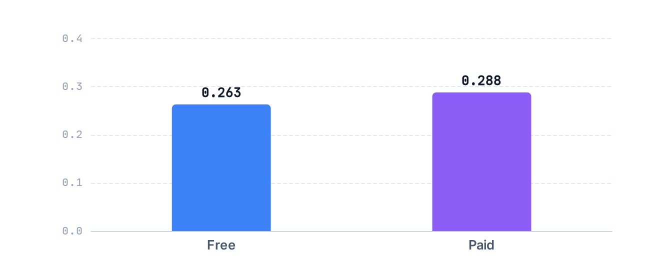







Q2: Sentiment Analysis — Free vs Paid Apps
Business Question
Avg Sentiment Polarity: Free vs Paid
Do paid apps generate more positive user sentiment than free apps? Measured via sentiment_polarity from the reviews table. A float score where +1 = most positive, −1 = most negative.
HOW WE MEASURED THIS
We join every review to its app, then group by app type (Free vs. Paid) and average the sentiment_polarity score within each group.
SO WHAT
Sentiment is a weak, secondary signal. Not strong enough on its own to justify charging for the app.
FREE APPS
PAID APPS
Key Finding
0.263
0.288
Paid apps score marginally higher in sentiment, but the gap is narrow — both types remain in the positive range. Sentiment alone is not a decisive factor for pricing.
Avg sentiment polarity
Avg sentiment polarity
INNER JOIN
GROUP BY
AVG()
Cross-table
Features:

Slide 7

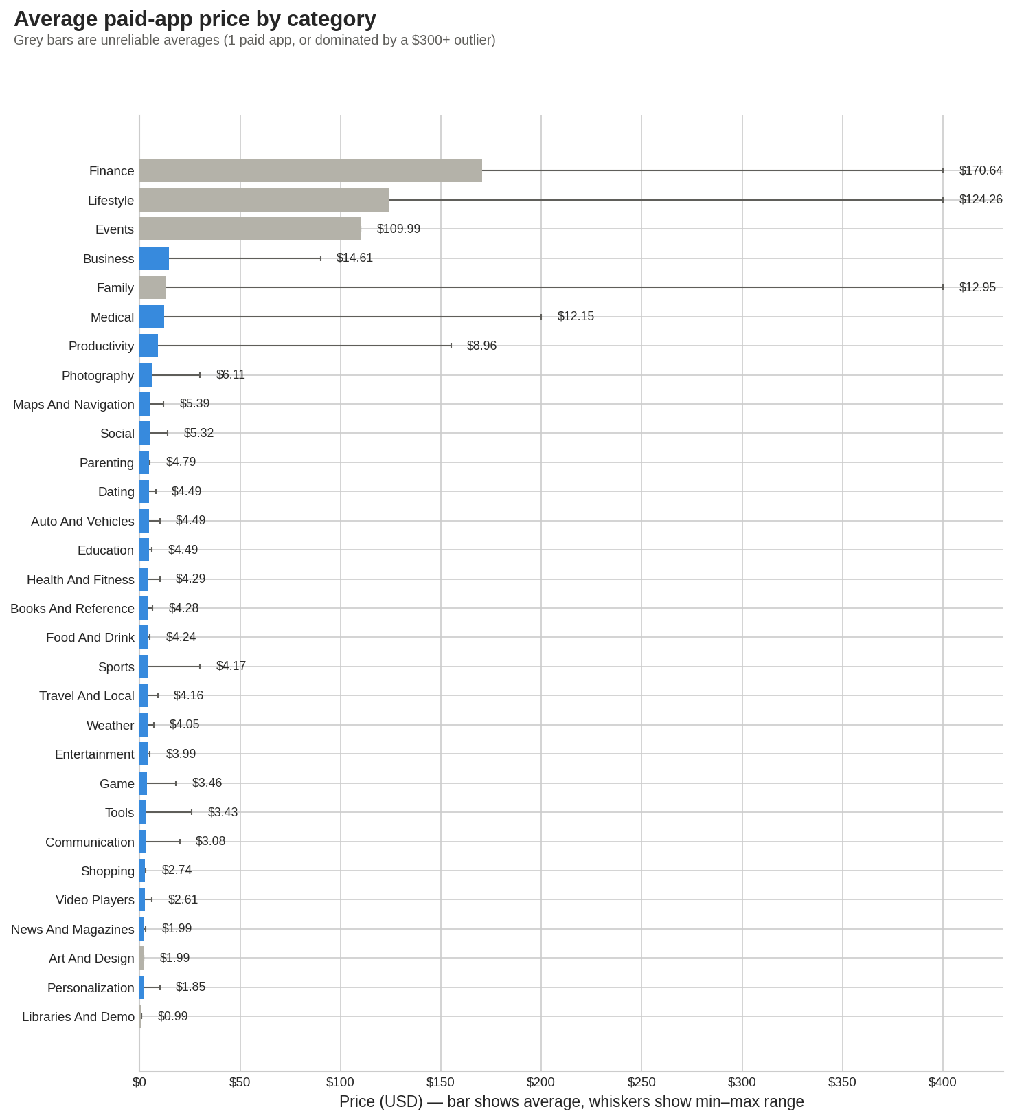

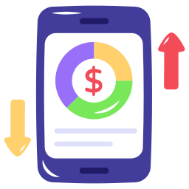
Q3: Average Pricing Trends per Category
BUSINESS QUESTION
Which app categories can realistically sustain a premium paid price?
KEY FINDING
Reliable pricing sits around $9–$15 (Business, Medical, Productivity). Headline highs , Finance ($170.64), Lifestyle ($124.26), Events ($109.99) are misleading: Events has just 1 paid app, and Finance/Lifestyle are pulled up by $400 outlier apps.
SO WHAT
Set pricing benchmarks off the stable mid-tier, not the highest raw average.
JOIN
WHERE
GROUP BY
MIN · MAX · AVG

Slide 8

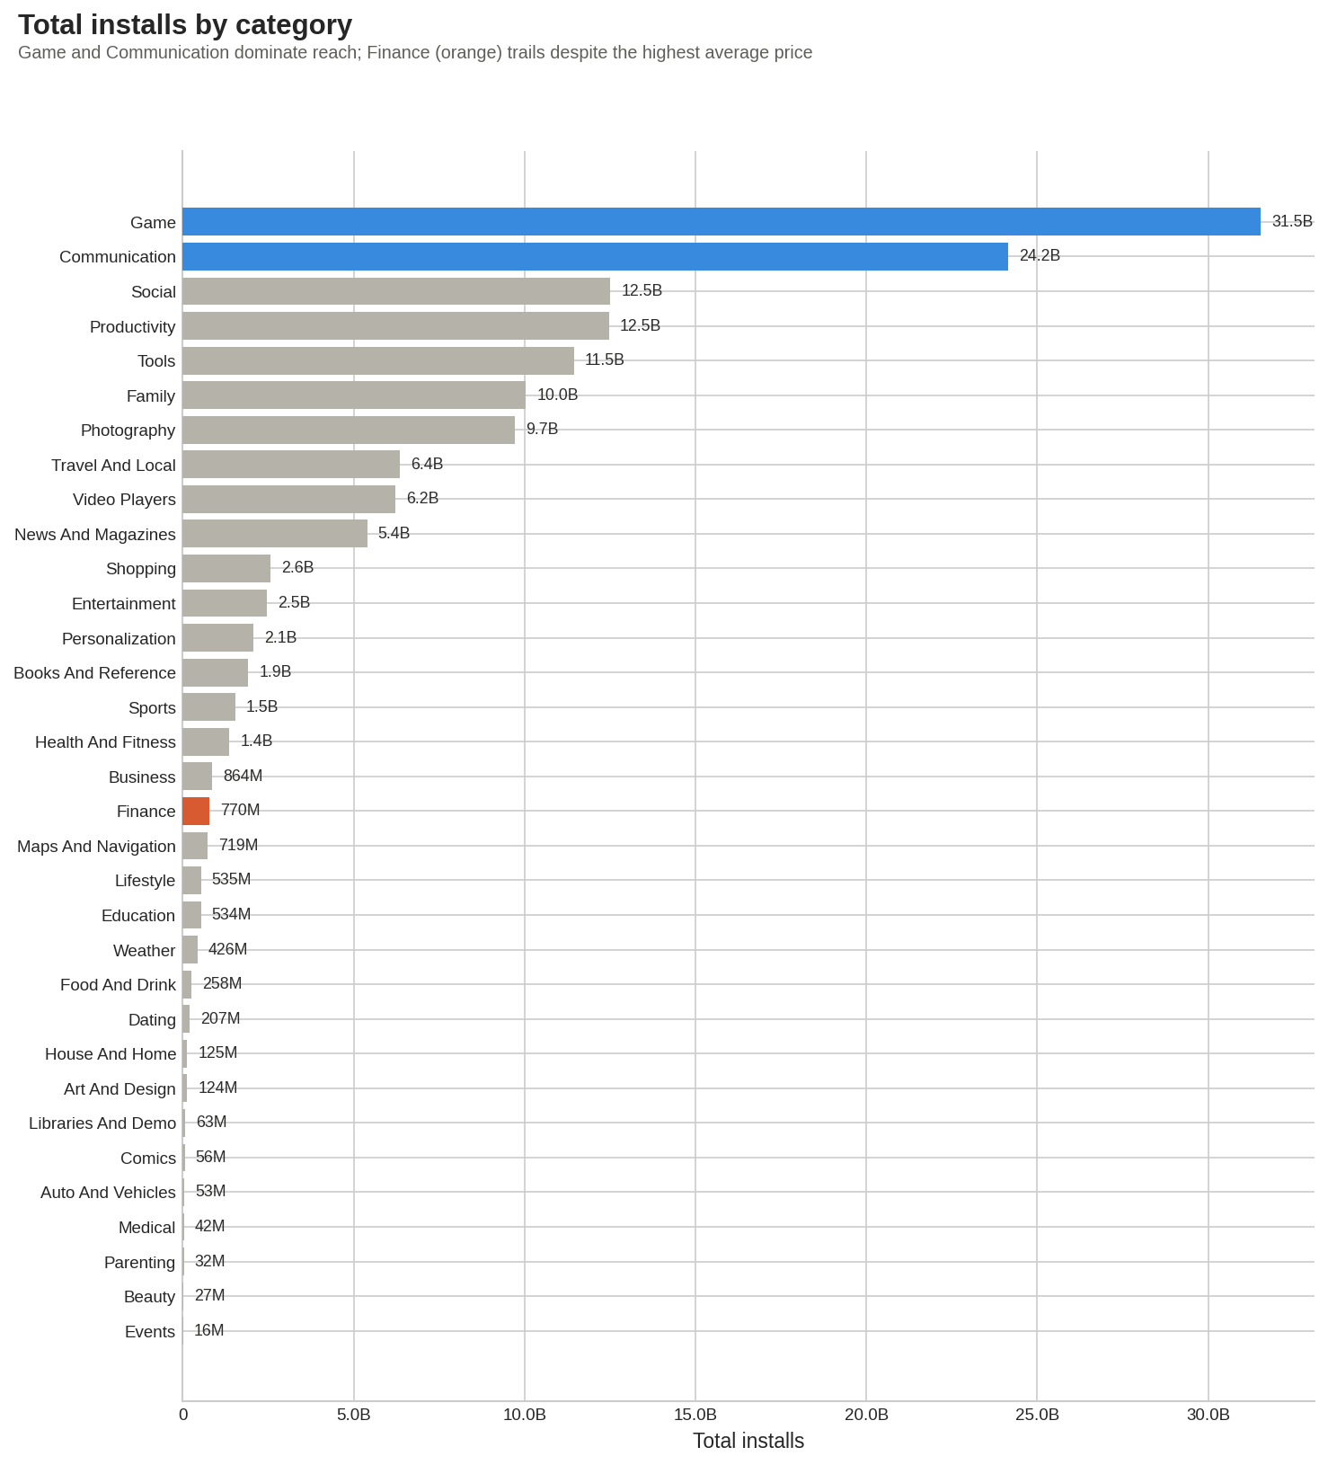


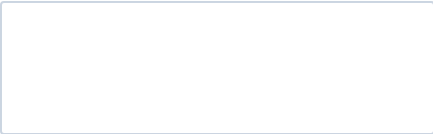
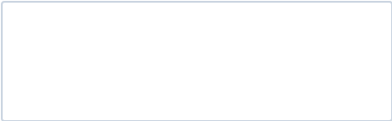




Q4: Total Install Counts by Category
BUSINESS QUESTION
Which categories give the agency the most reach?
KEY FINDING
Game (31.5B installs) and Communication (24.2B) dominate reach. Finance , the highest-priced category, ranks only ~15th (770M).
SO WHAT
High price ≠ high reach , scale needs free access.
LEFT JOIN Implementation
Aggregation by Category
Descending Volume Rank
All 33 Categories Included

Slide 9

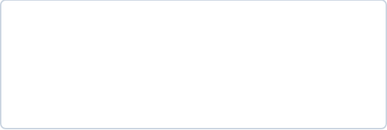

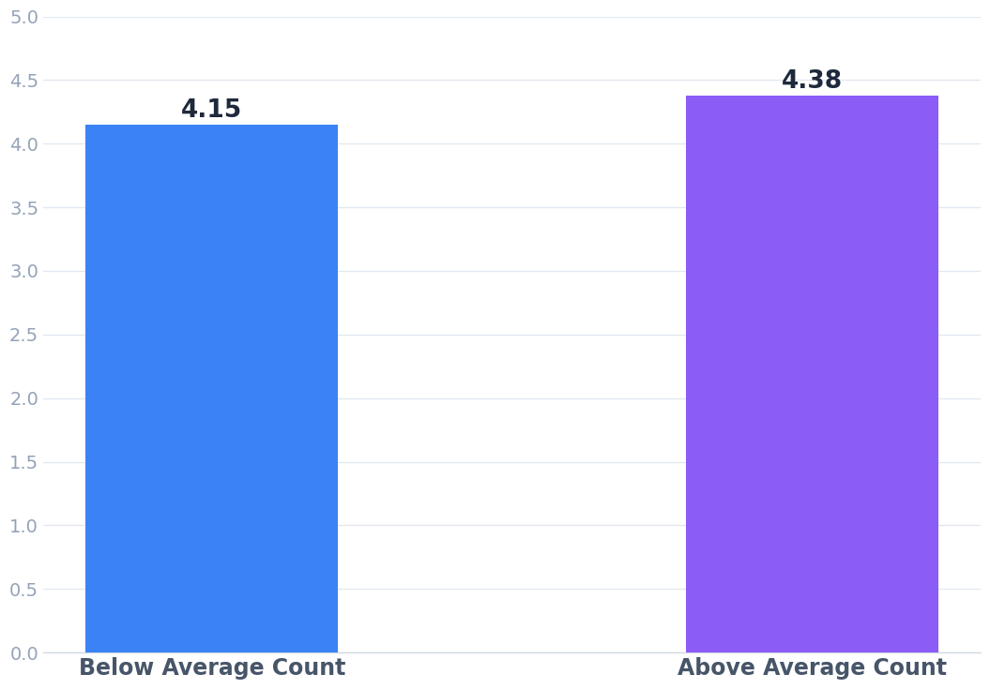

Q5: Relationship Between Review Volume and Ratings
BUSINESS QUESTION
TOTAL APPS ANALYZED
AVG RATING (GLOBAL)
10,356
4.19
Does review volume signal a higher-quality app?
KEY FINDING
Average Rating Comparison by Review Volume
Apps with above-average review counts rate modestly higher (4.38 vs 4.15) a real but small gap, and only ~10% of apps clear that bar.
SO WHAT
Treat review volume as a secondary indicator of app performance, not as evidence that more reviews cause higher ratings.
Subquery
CASE
GROUP BY
AVG
Source: queries.sql (MySQL 8.0)

Slide 10




Strategic Recommendations and Conclusion
01
Adopt a Freemium Pricing Model
Based on Q2 sentiment analysis, user polarity scores for Free vs. Paid apps show negligible variance. However, Q4 install data indicates that top-performing market segments are driven by massive download volumes achievable only via zero-entry price points.
TARGET IMPACT
Maximize top-of-funnel acquisition and rapid market penetration.
02
Separate Rating Niches from Scale Categories
Education has the strongest average rating, but the category spread is small. Game and Communication dominate total installs. Recommendation: choose the category based on product fit, then benchmark against the right goal: rating quality or market reach.
TARGET IMPACT
Achieve sustainable organic growth with lower churn rates.
03
Treat Reviews as Engagement, Not Proof of Quality
Apps with more reviews show higher average ratings, but the relationship is modest and not causal. Use review volume as an early engagement signal while improving ratings through product quality, onboarding, support, and review prompts.
TARGET IMPACT
Strengthen Store SEO and establish long-term brand authority.

Slide 11

Thank you
Matteo Grossi
Berker Ildokuz

